Slide 1
Working with Web Servers

Slide 2
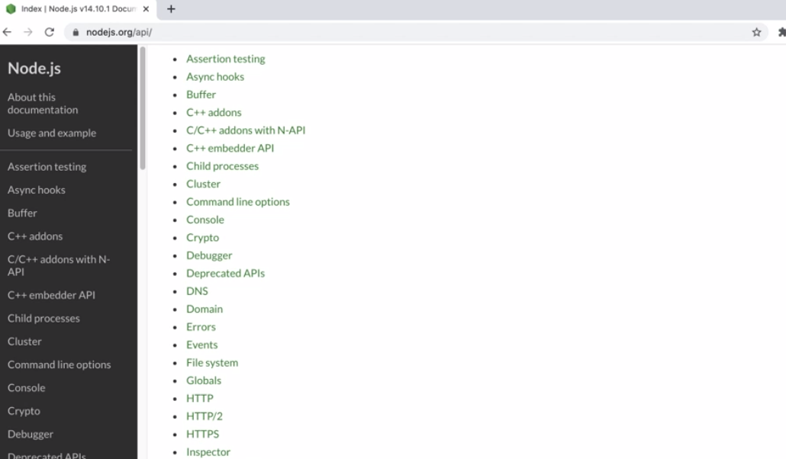

Slide 3
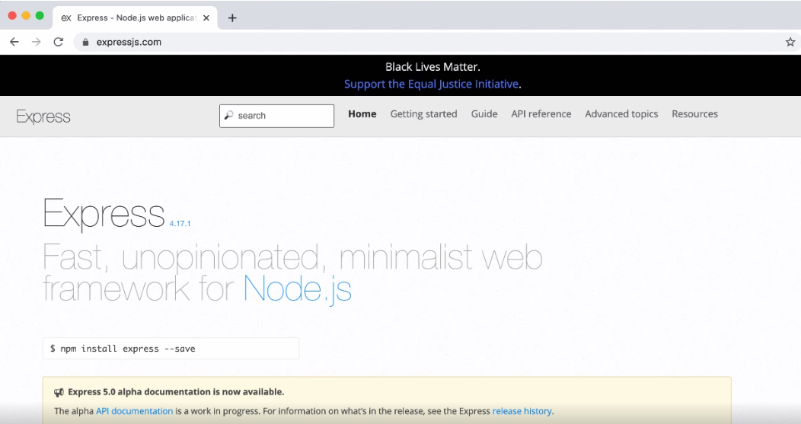

Slide 4
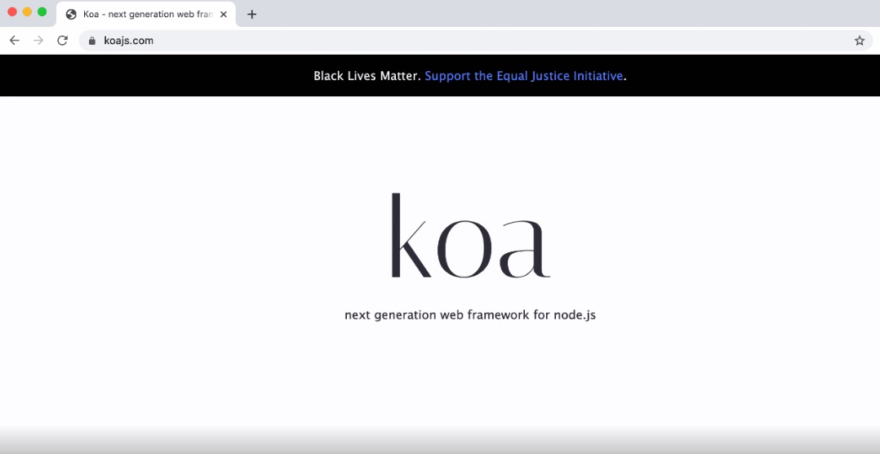

Slide 5
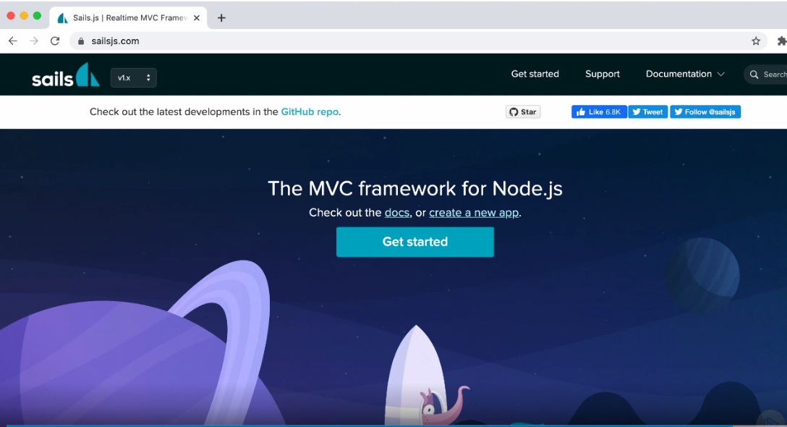

Slide 6


Slide 7
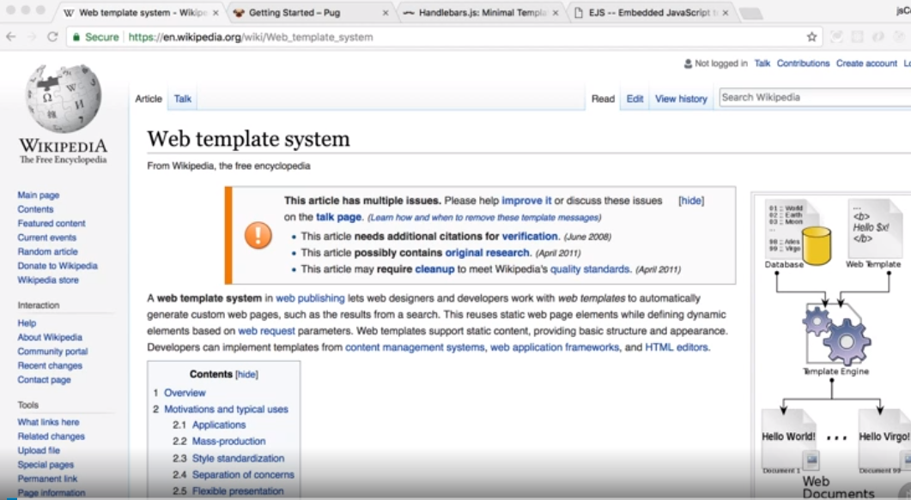

Slide 8
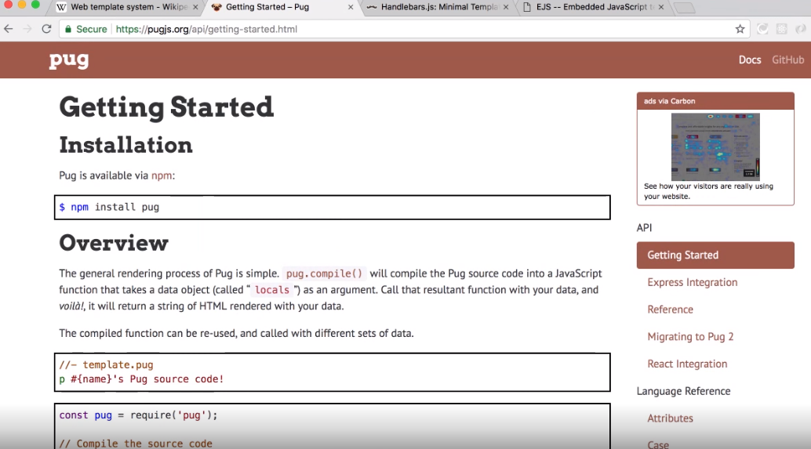

Slide 9
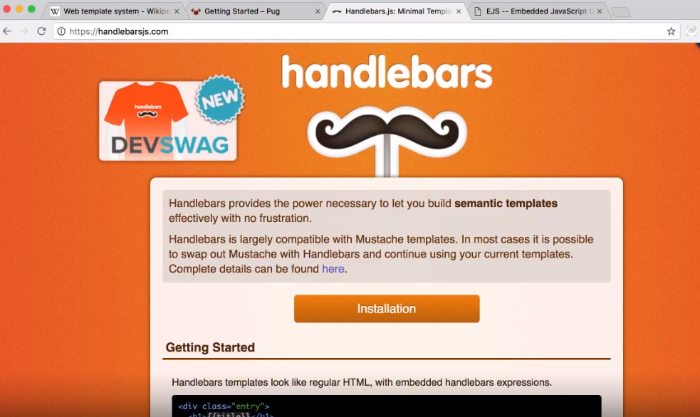

Slide 10
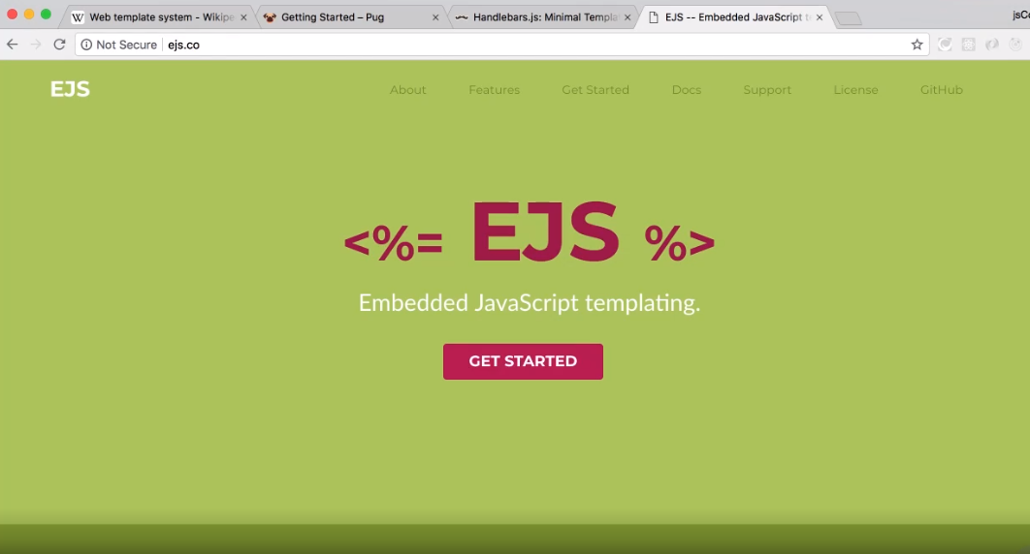

Slide 11
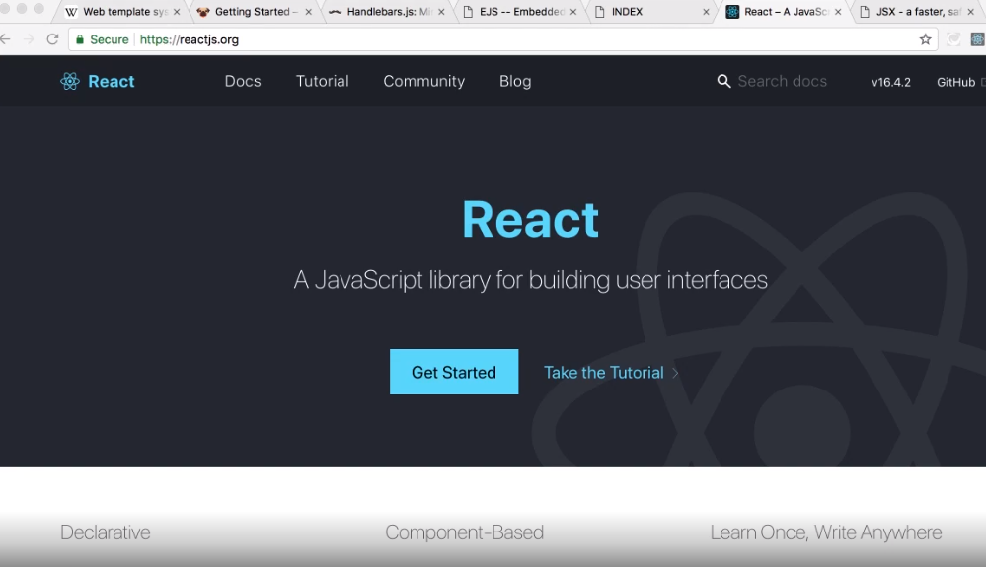

Slide 12

Node for web
Built-in modules Reloading Node
Wrap Up
The “req” and “res” objects
Express EJS

Slide 13
Next Up
Working with the Operating System

